Slide 1



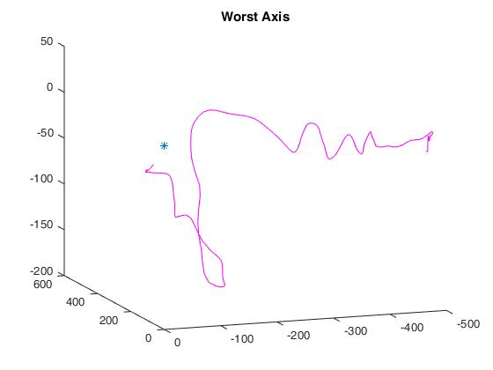
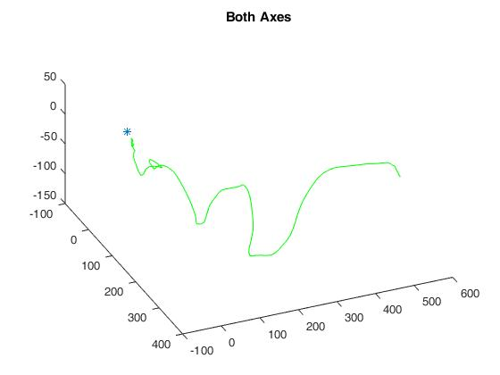
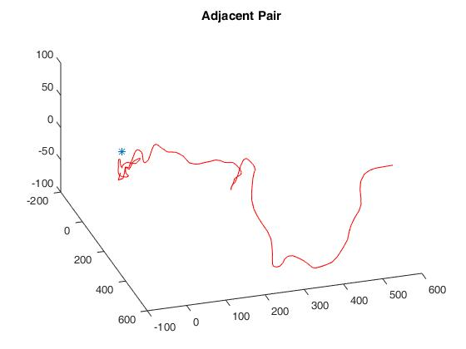
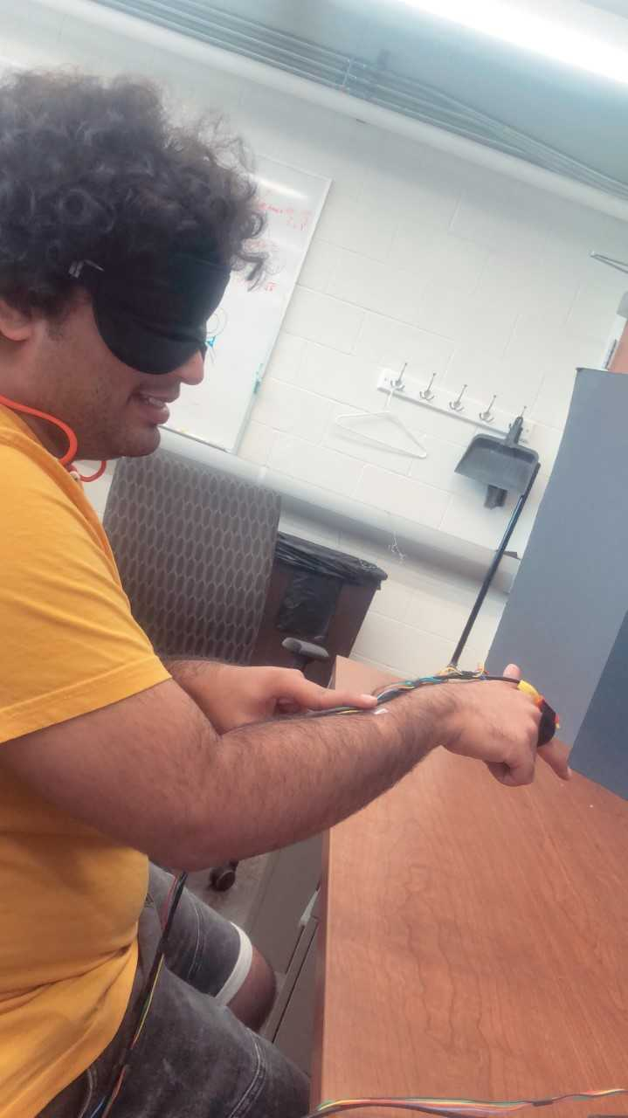
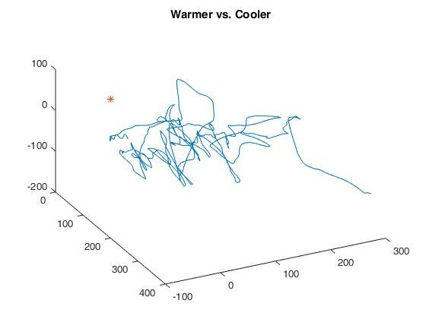
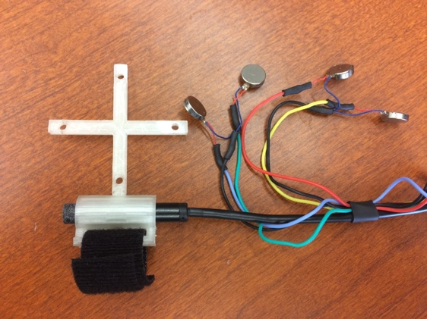
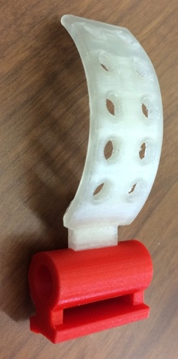
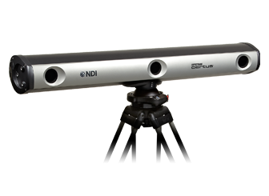
.
Validating FingerSight with a 3D Infrared Tracking System
Janet Canady¹, Shantanu Sapute¹, Roberta Klatzky², George Stetten^{1,2}.
¹Department of Bioengineering University of Pittsburgh.
Pittsburgh, PA. ²Department of Psychology Sciences, Carnegie Mellon University, Pittsburgh, PA.
Abstract
Methods
Results
Discussion
Our laboratory has been developing FingerSight, which relies on computer vision to recognize and locate specified targets, and then gives guidance via haptic feedback. It consists of a miniature camera and array of vibrators mounted on the finger. Controlled and rapid scanning of the visual environment is possible with the hand, providing the visually impaired user with the ability to “see” with their finger and use that information to navigate areas and find objects critical to their daily lives. To devise optimal control processes for this new human-machine system, we are developing a 3D tracking system for experiments with the FingerSight device, and report on our preliminary results here.
In the current preliminary experiment, the participant is blindfolded and attempts to reach a target using feedback from the vibrators, which are arranged around the finger in 90° increments, oriented to the dorsal, lateral, medial, volar aspects of the finger.(A)
The target, a 5 mm diameter white spot on a black background, is automatically identified in real time in the camera image using the OpenCV software library, and this information is used to activate the four vibrators through one of four activation strategies:
(E) Warmer vs. Cooler, in which all vibrators are activated when the target is seen moving closer to the center of the image,
(F) Adjacent Pair, in which two adjacent vibrators are simultaneously activated to indicate the proper direction of motion to better center the target in the image,
(G) Worst Axis, in which the participant is guided along the axis with the greatest error, one axis at a time by a single vibrator, and
(H) Both Axes, in which adjacent vibrators are alternately activated to indicate the proper direction of motion.
3D coordinates of each IR-LED are recorded by the Certus at 10 Hz and the centroid is computed. When the participant arrives at the target, the vibrators are all activated with a long pulse to indicate that the experiment is over.
E)
Figure E: The purple line indicates the plotted coordinates of the pathway for the Worst Axis strategy. The target is indicated by a blue asterisk (*).
While the other three strategies took under 20 seconds each, the Warmer vs. Cooler strategy took over one minute, with no apparent correlation between X, Y and Z axes. The Warmer vs. Cooler strategy gives only permissive cues, giving the user feedback on movement, unlike the others which are instructive strategies, in that tell the user which way to go even when standing still. The presence of controlled feedback is demonstrated by the fact that the guidance becomes more refined as the subject approaches the target. The Both Axes strategy proved to be the fastest, possibly because it is easier to discriminate the individual vibrators but also better to combine them within a short period of time. The Adjacent Pair strategy was thought to have confused the user as to exactly which vibrator was active. The Worst Axis strategy was thought to In these trials the Both Axes strategy appeared to result in the most direct path, with the x and y range decreasing as the subject approached the target in the z-direction.
F)
Background
Figure F: The green line indicates the plotted coordinates of the pathway for the Both Axes strategy. The target is indicated by a blue asterisk (*).
Conclusion
Computer vision (CV) application has long been effective in robotic navigation with industry application, but has yet to make significant impact in helping the blind and visually impaired
Despite the plethora of assistive technology developed for the visually impaired, navigation and reaching issues still lack convenient solutions and encourage primitive rectification
For example, while groping is a popular method of obtaining objects quickly, it increases risk of reaching unsafe obstacles
In addition to being high cost, current tech solutions are often inconvenient to operate and high maintenance
Using the tracking system, we were able to compare 4 control strategies. Future studies may include other strategies and record camera orientation as well as location using rigid body transformations. Experiments using multiple subjects will determine statistical significance of the differences between strategies. We expect to use these data to enhance the effectiveness of FingerSight devices used in various tasks.
G)
Figure 4. Hydrophobicity of α-integrin membrane-proximal residues correlates to CIB1 binding affinity
Future Implications
A
B
Figure G: The blue line indicates the plotted coordinates of the pathway for the Warmer vs. Cooler strategy. The target is indicated by a red asterisk (*).
αM
Future research with subjects will be done to further evaluate the effectiveness of guidance strategies as well as commercialization efforts. In addition to studying guidance strategies, we are holistically examining FingerSight by advancing 3D tracking features, researching mobile application compatibility and obtaining data from focus groups.
α4
αIIB
αV
α2
α5
αL
α3
Rapid Prototyping
Figure 4. A) Total hydrophobicity of first six residues in each peptide tested compared to binding affinity measured by ITC. B) Hydrophobicity of membrane-proximal regions of all α-integrins used to predict range of CIB1 binding affinity.
Preliminary study
Experimentation with multiple subjects to determine statistical significance
Analysis of camera-3D coordinate relationship to obtain real time coordinates with FingerSight
Re-evaluation and modification of prototype
Attainment of focus group data to analyze specific application of FingerSight
A)
B)
C)
H)
Subject undergoing buzzer discrimination testing before guidance strategy testing
Figure H: The red line indicates the plotted coordinates of the pathway for the Adjacent Pair strategy. The target is indicated by a blue asterisk (*).
The current FingerSight device is composed of four cell-phone vibrators, as well as a miniature camera mounted to the proximal phalanx of the index finger. Attached to the device is an array of four infrared LED markers to be detected by an Optotrak Certus (NDI, Inc.)
D)
3D plots of the path of the centroid over time are shown below for a single subject and trial. All trials were successful in guiding the subject to reach the target, marked at the origin of each graph. The experiment using the Worst Axis (Figure 1) strategy took 16.9 seconds. Performing the task with the Warmer vs. Cooler vibrator activation (Figure 2) strategy took 87.2 seconds to complete. The Adjacent Pair strategy took 17.2 seconds (Figure 3) and the Both Axes (Figure 4) strategy took 16.1 seconds.
Acknowledgements
Marker number increased from n=4 to 10 for location accuracy. Corresponding array shown.
The Optotrak Certus (NDI, Inc.) records 3 dimensional translational and rotational coordinates of each IR-LED
Funding provided by the Swanson School of Engineering and the Office of the Provost at the University of Pittsburgh, NSF grant ILS-1518630, as well as the Pittsburgh Innovation Challenge (PInCh). We wish to thank Pitt EXCEL for guidance and support.

