Slide 1
FingerSight: A Device for the Blind
Janet Canady, Faculty Advisor: George Stetten, Shantanu Sapute
Visualization and Image Analysis Laboratory Swanson School of Engineering
Department of Bioengineering
University of Pittsburgh
Notes:
No side stories, no notecards, animate, 10 min (12 max) Add lots of pictures no new ideas

Slide 2
3.2 million visually impaired Americans
37% employment rate
Current corrective technologies are high cost and inconvenient
Sonic Canes - $800
AI Glasses - $2500
Varma, R et al, “Visual impairment and blindness in adults in the United States: Demographic and Geographic Variations from 2015 to 2050,” JAMA Ophthalmology, DOI:10.1001/jamaophthalmol.2016.1284.
https://nfb.org/images/nfb/publications/jbir/jbir15/jbir050202.html
Notes:
Problem
+Sonic Canes was over double the weight of a traditional cane
+Or-Cam My Eye attachment could actually make your vision worse
+Give prices:
Meanwhile, 3.2 million Americans had visual impairment in 2015 — meaning they had 20/40 or worse vision with best possible correction
https://www.nih.gov/news-events/news-releases/visual-impairment-blindness-cases-us-expected-double-2050

Slide 3
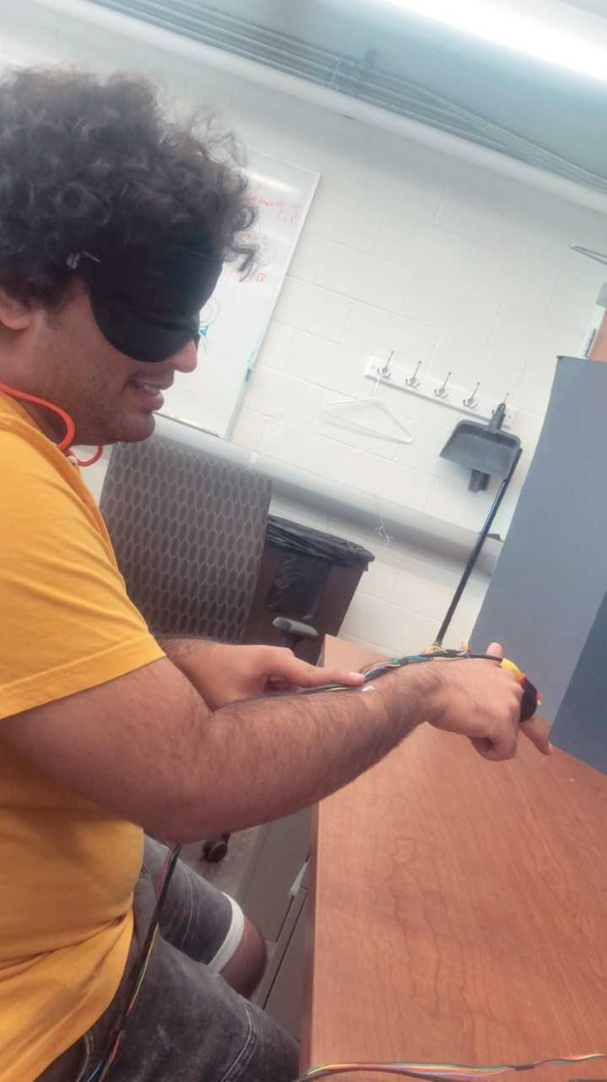
FingerSight, A cheap, convenient assistive technology
The development of FingerSight will successfully assist the visually impaired with guidance
Provides guidance through vibrotactile feedback
Notes:
Our solution
By 4 small cell phone buzzers

Slide 4
How it works:
1. User inputs object of choice
2. Object detected by camera
3. Corresponding buzzer vibrates
4. The user responds by moving
Notes:
1. What the device is (camera)
2. User inputs an object of choice
3. The object is detected by the camera
4. The corresponding buzzer vibrates, telling the user which direction to move
5. The user responds by moving
This mechanism which the user is constantly being told to move by method of touch is called haptic feedback

Slide 5
Objective
My Goal: To develop a functional prototype of the FingerSight device for experiments
Notes:
My goal was to come up with a successful prototype
I report the design process here.

Slide 6
Materials
Prototype
Testing
50 mm Camera
PLA Plastic
Velcro Strip
4 buzzers
SolidWorks
10 Infrared LEDs
Optotrak Certus
Notes:
Computer vision software for camera detection, solidworks for rapid prototyping described in the next slide, certus for recording 3D location at 10 frames a second

Slide 7
Design Process
1
2
Design
Test Parameters
Optimize
3
Repeat
4
Notes:
1.
2. Tested the prototype through a series of preliminary studies looking to see actual guidance checking to see if we could fit each of the aims successfully.

Slide 8
Success Criteria
The goal of FingerSight is guidance.
If we see a correlation between x, y, and z criteria, we knew the device was functional.
Testing Time: 20 s
Notes:
While there was no original standard, after doing a few sets of preliminary studies, we determined that 20 seconds was the optimal time to guide a subject 2.5 feet.

Slide 9
Comfort Cost Coordinates Control
Parameters:

Slide 10
Comfort
Wearable Design
Adjustable Velcro strap
Detectable vibrations
1/8 in
Notes:
+ Comfort – Wanted a wearable design that doesn’t fall off
+Gap
+Too large:
+show original design
+Show gaps constantly changing

Slide 11
Cost
Inexpensive materials and production
> 2 sq inches of plastic
Camera ($15)
Buzzers ($.40 for 4)
Velcro Strips ($1.32 for 4 inches)
Estimated Cost: $100
Notes:
+ Cost – Wanted not only inexpensive materials but a simple manufacturing process for easy production at large scale

Slide 12
Coordinate Tracking
Planar Array
Curved Array
Holds 4 IR-LEDs
Uniplanar
1 in x 1 in
Holds 10 IR-LEDs
90˚
1 in x .5 in
Notes:
+Coordinate Tracking – Wanted to make sure the prototype can actually provide guidance, so I made a design that would allow for 3D tracking of the object in a room

Slide 13
Control
Prototype used to do a preliminary study
Blindfolded subjects reach target using buzzer feedback
Guided feedback
Strategy | Guided | Target
Time (s) | 16.9 | 20
Notes:
Control Strategy was permissive cues with all buzzers on and off. The prototype had to allow for subjects to tell apart the buzzers.
+Control – Wanted to make sure that people are getting the vibration cues they need, so after making physical adjustments we then

Slide 14
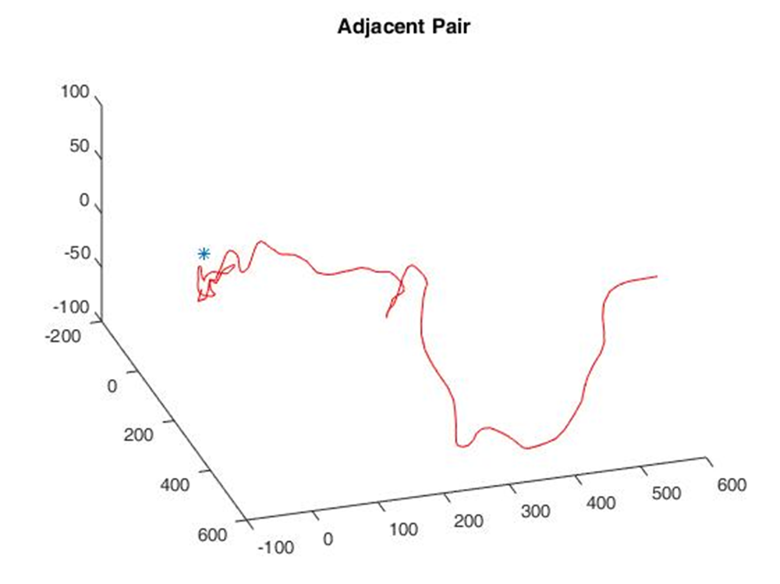
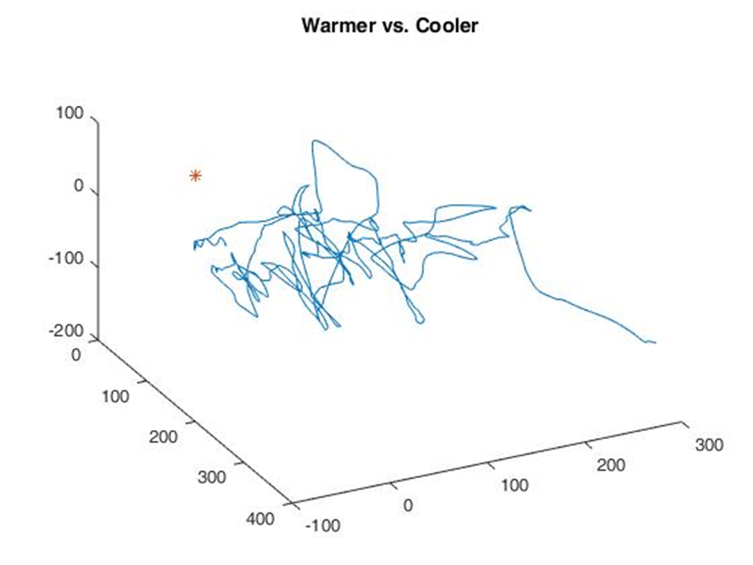
Unguided Strategy
Guided Strategy
X (mm)
Y (mm)
Z (mm)

Slide 15
Final Design
4 buzzers arranged around the finger at 90˚ increments for guidance
Camera Holder: Slit for Velcro
Prevents rotation of camera holder
Array: 10 holes for LEDs
More accurate location tracking
Notes:
Need pictures

Slide 16
Success Criteria
 | Finger -Sight | Sonic Canes | AI Glasses
Comfort | Less than 1 in³ | 36 in | 3 in
Cost | $100 | $800 | $2500
Coordinate | Can track | -------- | -------
Control | Yes | Yes | Yes
Notes:
Make into a table( Compare to original designs)

Slide 17
Future Steps
Other haptic techniques
Combine with existing applications
Computer Vision Software
BVA studies

Slide 18
Acknowledgements
Office of the Provost and Swanson School of Engineering
VIA Laboratory members
Sossena Wood and Pitt EXCEL

Slide 19
Questions?
Thank you!

